Slide 1

Co-Brand: Malibu Boats x Chubbies

Slide 2
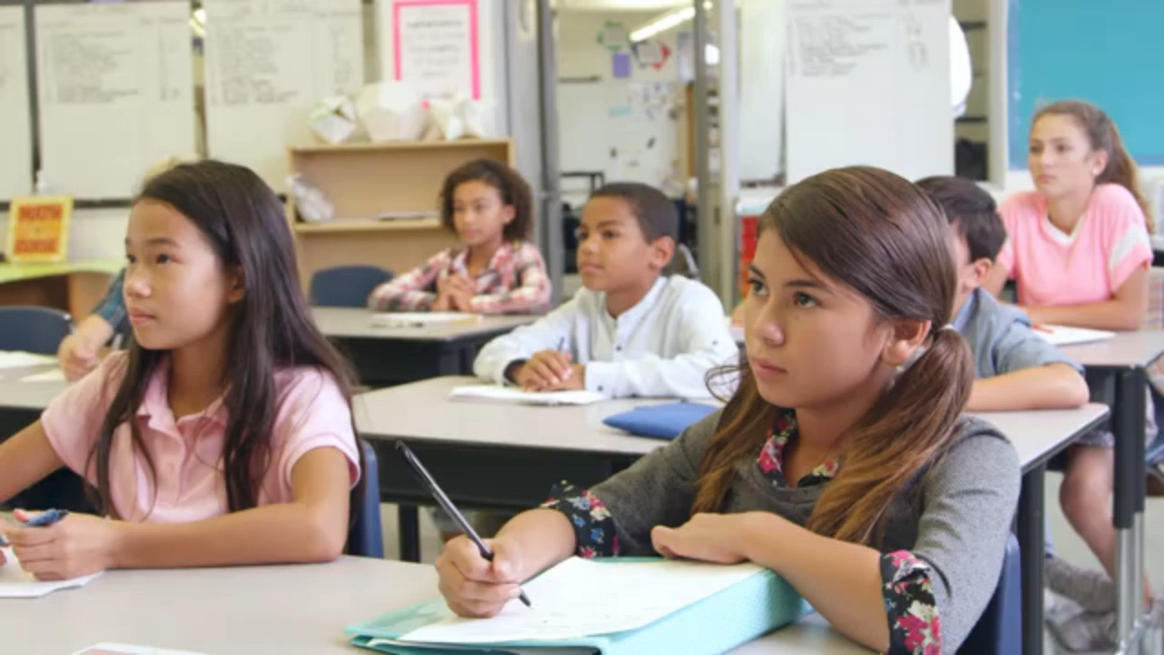
National Center for Missing and Exploited Children

Slide 3

National Center for Missing and Exploited Children

Slide 4
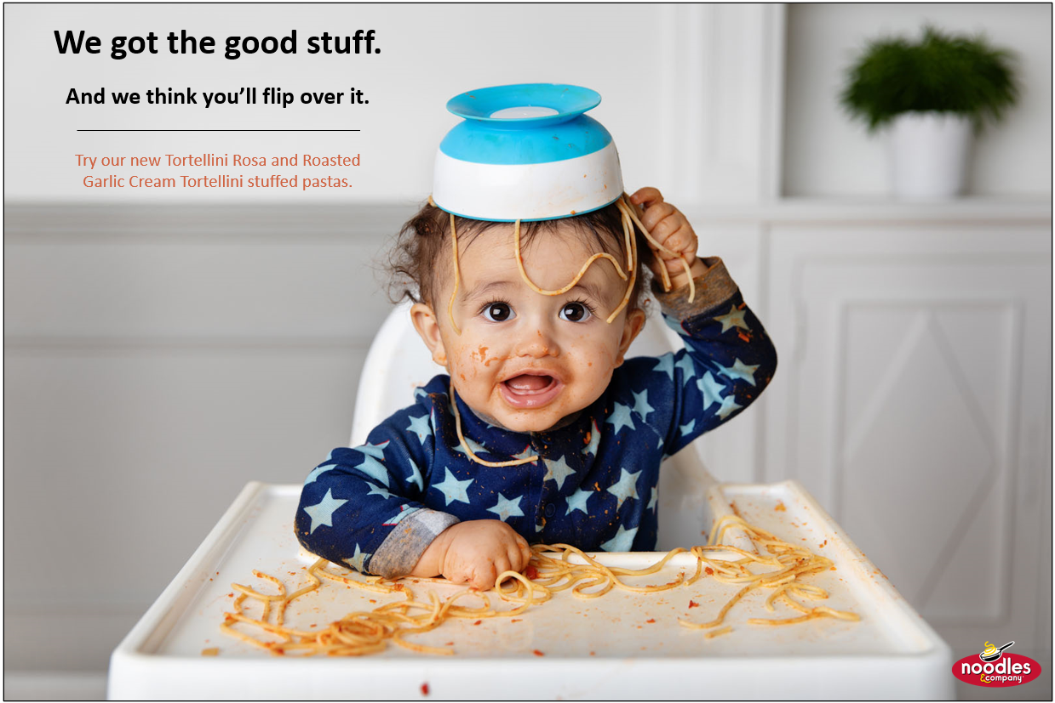

Noodles & Co.

Slide 5



McDonald’s

